Slide 1
NCBI PowerScripting
Lecture 2:
Introduction to the eUtils
April 20-22, 2005

Slide 2
Outline
The Basics: Syntax of eUtil URLs
The Entrez Core
  EGQuery, ESearch, ESummary
Entrez Databases
  EInfo, EFetch, ELink
The Entrez History Server
  EPost

Slide 3
The Base URL
http://eutils.ncbi.nlm.nih.gov/entrez/eutils/
eutil.fcgi?
esearch.fcgi?
egquery.fcgi?
esummary.fcgi?
einfo.fcgi?
elink.fcgi?
efetch.fcgi?
epost.fcgi?

Slide 4
URL Parameters
BASE/
esearch.fcgi?
db=nucleotide&term=mouse[orgn]
Parameters are separated by & symbols
db = nucleotide
term = mouse[orgn]
We need to know the following:
What parameters are available
What values they accept

Slide 5
The Entrez System
Entrez Core Engine
Finds Unique Identifiers (UIDs) that match a text query
Displays Document Summaries for each matching UID
User
Entrez Databases
Entrez History Server
Provides formatted data records indexed by UID to the Core Engine
Provides Entrez links for each UID
Stores separate search histories for each Entrez database

Slide 6
The Entrez Core
Entrez Core Engine
EGQuery
Finds Unique Identifiers (UIDs) that match a text query
Displays Document Summaries for each matching UID
ESearch
ESummary
These work for ALL DATABASES!!!
text query
EGQuery
count of UIDs
text query
ESearch
set of UIDs
set of UIDs
ESummary
DocSums

Slide 7
EGQuery
Performs a global Entrez search across all databases
Why use it?
To find the number of records matching a text query
INPUT
term
Entrez text query
BASE/
egquery.fcgi?
term=mouse[orgn]
OUTPUT
XML
Number of records matching the query in
each database

Slide 8
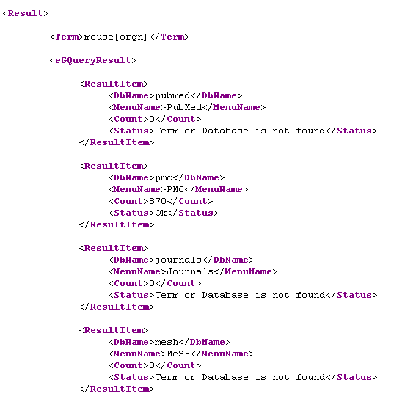
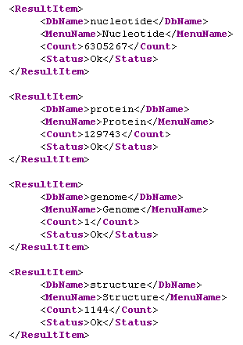
EGQuery Output

Slide 9
ESearch
Performs an Entrez search in one specified database
Why use it?
To find UIDs that match a text query
INPUT
db
Entrez database to search
term
Entrez text query
BASE/
esearch.fcgi?
db=nucleotide&term=mouse[orgn]
OUTPUT
XML
Total number of records matching the query
Partial list of matching UIDs
Term translations

Slide 10
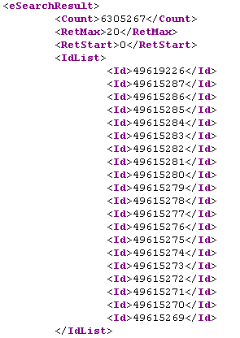
ESearch Output – UIDs
Total number of records found
&retmax
&retstart
first record = &retstart
Matching UIDs
quantity = &retmax

Slide 11
Retrieval Parameters
These work for ESearch, ESummary, and EFetch
retstart
First record to retrieve from UID set (default = 0)
retmax
Number of records to retrieve from UID set
&retmax=4
(84, 23, 19, 55, 20, 96, 73)
(84, 23, 19, 55)
&retstart=2&retmax=4
(84, 23, 19, 55, 20, 96, 73)
(19, 55, 20, 96)

Slide 12
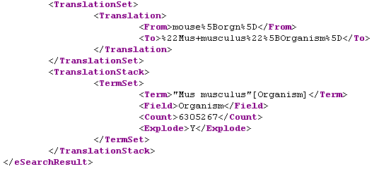
ESearch Output – Translations
Term translations: equivalent to the Details link on the web
mouse[orgn]
“Mus musculus”[Organism]

Slide 13
Look at the Time!
Date format: YYYY/MM/DD
reldate=n
Retrieve UIDs with dates less than n days prior to today
mindate
Retrieves UIDs in this date range
These parameters must be used together!
maxdate
datetype
Type of date to examine:
Most Entrez databases only support two of these date types!
mdat Modification date: date the record was last touched
pdat Publication date: date the record was made public
edat Entrez date: date the record entered Entrez
cdat Creation date: date the record was created

Slide 14
ESummary
Retrieves Document Summaries matching a set of UIDs
Why use it?
To download data
It’s fast and can download large sets with one URL
If EFetch does not support your database
INPUT
db
Entrez database to search
id
Set of UIDs
BASE/
esummary.fcgi?
db=nucleotide&id=49619226,49615287
OUTPUT
XML
DocSums, often with more data than web
Entrez provides

Slide 15
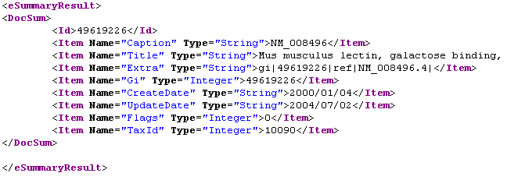
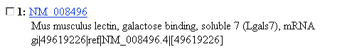
ESummary Output

Slide 16
Entrez Databases
Provides general information about a specific database
Provides formatted data records indexed by UID
Provides Entrez links for each UID
EInfo
Entrez Databases
EFetch
ELink
The function of these depends on the chosen Entrez database!
Entrez database
EInfo
database statistics
set of UIDs
EFetch
Formatted Data
set of UIDs in db A
ELink
set of UIDs in db B

Slide 17
EInfo
Provides indexing fields and overall statistics for an Entrez database
Why use it?
To get a list of all indexing fields in a database
To find all possible links to and from a database
INPUT
db
Entrez database to search
BASE/
einfo.fcgi?
db=nucleotide
OUTPUT
XML
General indexing statistics
List of indexing fields and counts of records
List of available Entrez links for the database

Slide 18
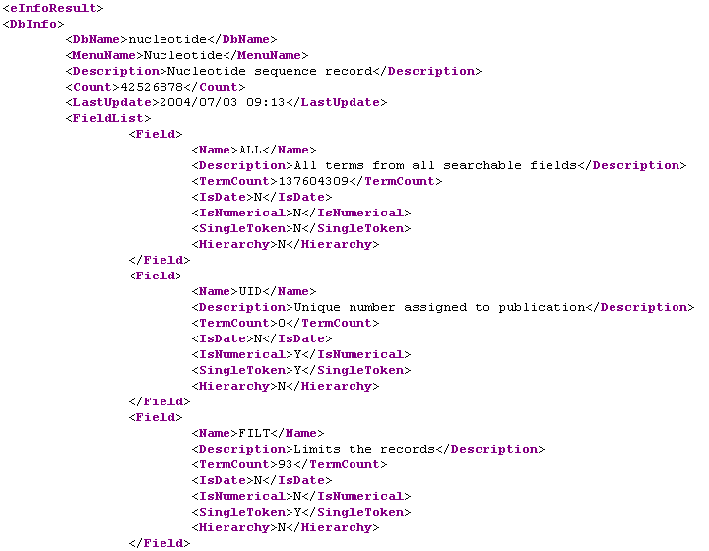
EInfo Output - Fields

Slide 19
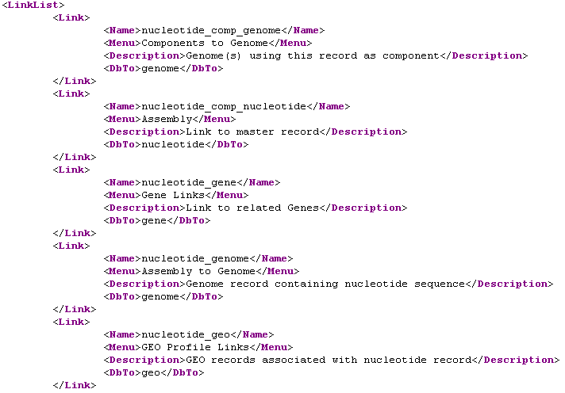
EInfo Output - Links

Slide 20
EFetch
Retrieves formatted data records matching a set of UIDs
Why use it?
To download data records
INPUT
db
Entrez database to search
id
Set of UIDs
BASE/
efetch.fcgi?
db=nucleotide&id=49619226,49615287
OUTPUT
Varied
Formatted data records

Slide 21
Databases that Support EFetch
Literature
PubMed
Journals
PubMed Central
Sequences
Nucleotide
Protein
Genome
Popset
SNP
Other
Gene
Taxonomy

Slide 22
EFetch Formatting Parameters
rettype
Determines the type of data record returned
(flat file, FASTA, EST, accession, etc.)
retmode
Determines the format (mode) of data record returned
(text, HTML, XML)
Be warned!
These settings are very dependent on the database
These settings interact with one another
Not all possible combinations are supported

Slide 23
EFetch for PubMed
retmode
default = HTML
text XML asn1
rettype
default = ASN.1
medline citation abstract uilist
To retrieve text abstracts:
&retmode=text&rettype=abstract
To retrieve HTML abstracts:
&retmode=html&rettype=abstract
To retrieve text medline:
&retmode=text&rettype=medline
To retrieve full XML:
&retmode=xml&rettype=

Slide 24
EFetch for Sequences
retmode
default = text
HTML XML
rettype
default = native
gb gp gbwithparts fasta gss est acc
To retrieve text GenBank flat file:
&retmode=text&rettype=gb
To retrieve HTML GenPept flat file:
&retmode=html&rettype=gp
To retrieve test FASTA:
&retmode=text&rettype=fasta
To retrieve TinySeqXML:
&retmode=xml&rettype=fasta
To retrieve full XML:
&retmode=xml&rettype=native

Slide 25
Retrieving Batches
A single EFetch URL can download a maximum of 500 records!
&retstart=0&retmax=500
Retrieve successive batches
of 500 records until the entire
dataset is downloaded
&retstart=500&retmax=500
&retstart=1000&retmax=500
…
Batch retrieval is easily implemented using a for loop:
for ($retstart=0; $retstart < $total; $retstart+=$retmax) {
… &retstart=$retstart&retmax=$retmax…
}

Slide 26
ELink
Retrieves UIDs in database B linked to a set of UIDs in database A
Why use it?
To find related data in another database
To find neighbors within a database
INPUT
dbfrom
Entrez database to link from
db
Entrez database(s) to link to; can be a list!
id
List of UIDs
cmd
ELink command mode (default = neighbor)
BASE/
elink.fcgi?
dbfrom=nucleotide&db=protein&id=49619226
OUTPUT
XML
Set(s) of linked UIDs

Slide 27
Computational Neighbors in ELink
Retrieves UIDs linked to other UIDs in the same database
dbfrom
=
db
BASE/
elink.fcgi?
dbfrom=protein&db=protein&id=15718680
term
Entrez query that ELink uses to limit the set of neighbors
Supported databases:
pubmed cdd
nucleotide geo
protein gds
domains

Slide 28
Passing One UID Set to ELink
dbfrom=gene&db=protein&id=G1,G2,G3
G1
G2
G3
P1
P2
P3
P4
P5
P6

Slide 29
Passing Multiple UID Sets to ELink
dbfrom=gene&db=protein&id=G1&id=G2&id=G3
G1
G2
G3
P1
P2
P3
P4
P5
P6

Slide 30
Passing Multiple UID Sets to ELink
dbfrom=gene&db=protein&id=G1,G2&id=G3
G1
G2
G3
P1
P2
P3
P4
P5
P6

Slide 31
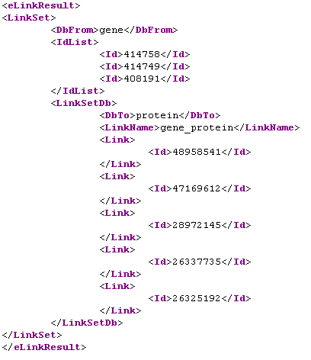
ELink Output
dbfrom=gene&db=protein&id=414758,414749,408191

Slide 32
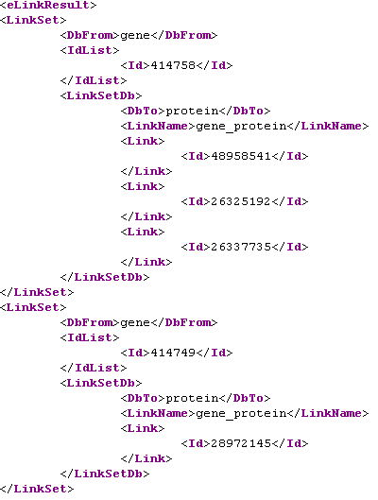
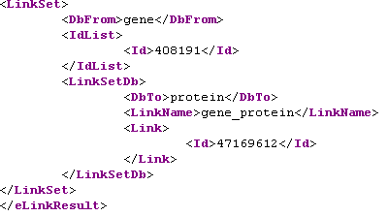
ELink Output
dbfrom=gene&db=protein&id=414758&id=414749&id=408191

Slide 33
The Entrez History Server
Entrez History Server
EPost
Stores separate search histories for each Entrez database
ESearch
ELink
The History Server represents the location of stored UID sets with two parameters:
WebEnv
A string specifying a cookie assigned by the History Server
query_key
An integer equivalent to the History number on the web

Slide 34
Accessing the History
WebEnv
EPost
ESearch
query_key
Entrez History Server
ESummary
ESearch
usehistory=y
EFetch
ELink
ELink
cmd=neighbor_history

Slide 35
EPost
Stores a list of UIDs on the History Server
Why use it?
To upload a large file or set of UIDs
INPUT
db
Entrez database containing UIDs
id
List of UIDs
WebEnv
Pre-existing WebEnv to use
BASE/
epost.fcgi?
&db=nucleotide&id=49619226,49615287
OUTPUT
XML
WebEnv
query_key

Slide 36
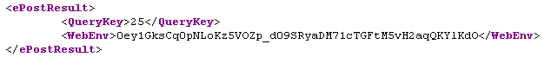
EPost Output
query_key
WebEnv
UIDs can be passed to EPost in two ways:
In the &id parameter in a URL (limited to ~500)
In the &id parameter using the POST method (can post thousands)
Using method 2, UIDs can be posted from a file, and EPost becomes
the equivalent of Batch Entrez on the web

Slide 37
ESearch
Performs an Entrez search in one specified database
INPUT
db
Entrez database to search
term
Entrez text query
usehistory
Flag ( =y ) for ESearch to access History
WebEnv
Pre-existing WebEnv to use
BASE/
esearch.fcgi?
db=nucleotide&term=mouse[orgn]&usehistory=y&WebEnv=A1C3
OUTPUT
XML
Total number of records matching the query
Partial list of matching UIDs
Term translations

Slide 38
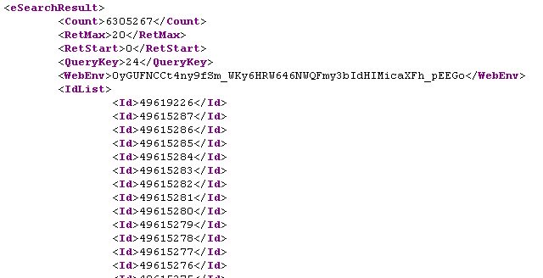
Using ESearch to Post Results
BASE/
esearch.fcgi?
db=nucleotide&term=mouse[orgn]&usehistory=y
query_key
WebEnv

Slide 39
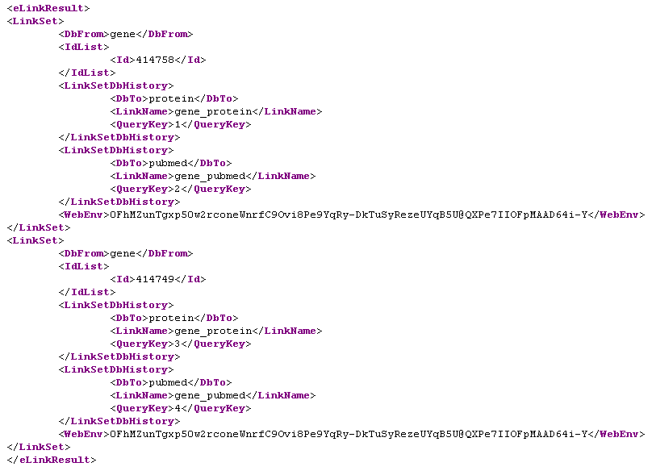
Storing Linked Sets with ELink
cmd=neighbor_history&dbfrom=gene
&db=protein,pubmed&id=414758&id=414749
Unique query_keys
Common WebEnv

Slide 40

Finally, Now for Your UID!
Please use both of these parameters in your URLs in case there are problems
tool
a unique name for your software package
email
your email address, so we can contact you…
&tool=mr.gene&email=funwithgenes@big.genomics.com

